Slide 1
Predicting car accident severity

Slide 2
Predicting future possible accident
Based on the objective, Condition of road, vehicle, driver’s condition(under drugs/alcohol, is attentive?), area ,etc.. may influence our decision.
People would be interested in knowing the possibility of occurring an accident.
Police could prevent crashes on taking required actions based on probability of an accident to occur.

Slide 3
Data source and data cleaning
Dataset includes all types of collisions from 2004 to present in Seattle which was provided within coursera.
This is an extensive data set from the Seattle Police Department, with over 190,000 observations collected over the last 15+ years.
Redundant attributes were dropped
Data set is imbalanced which has been balanced by oversampling.
Missing values are filled with the highest frequency values with respect to their attributes as almost all are categorical variables.

Slide 4
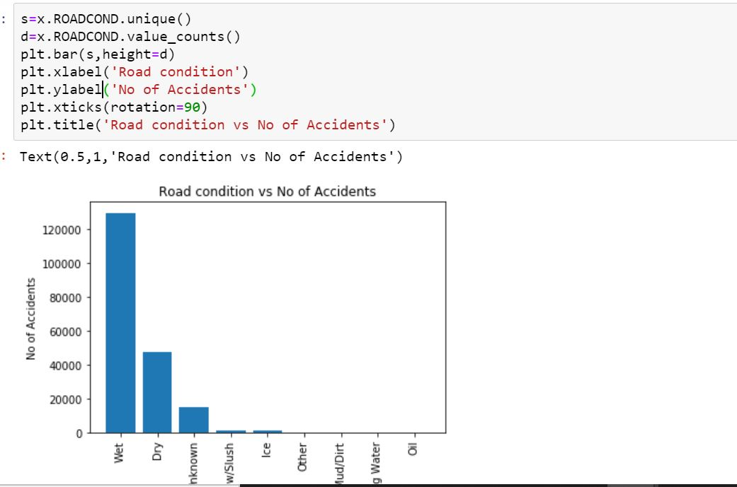
Wet roads contribute the most of accidents compared to other roads

Slide 5
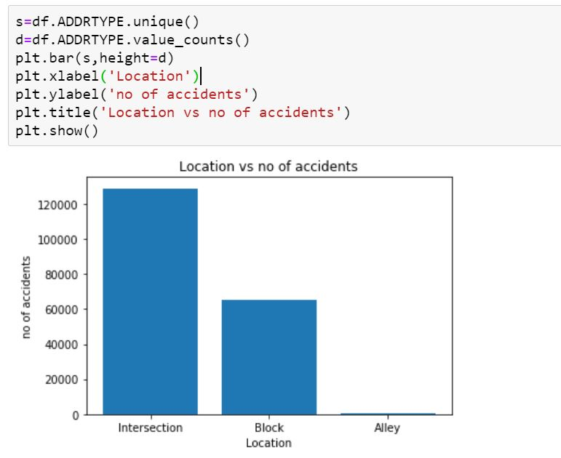
Intersections are the most common accident zone

Slide 6
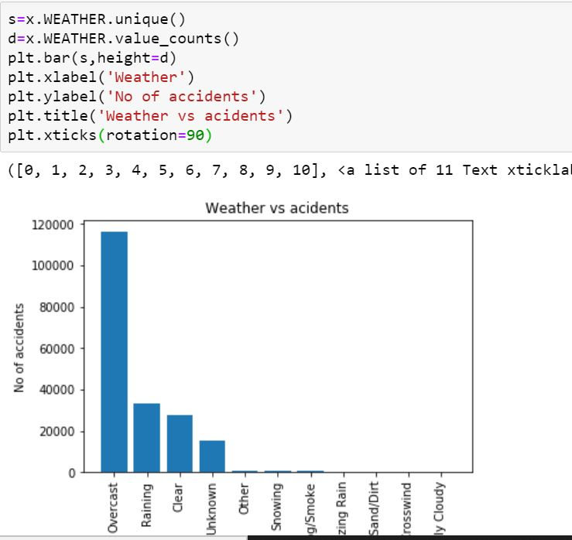
Overcast conditions cause more accidents than rainy or snowy

Slide 7
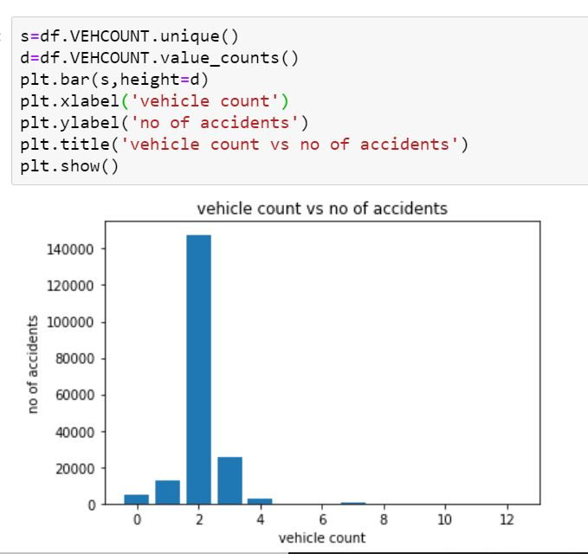
Most accidents include 2-3 vehicles at once

Slide 8
Algorithms
After balancing features, and standardizing , I have employed two classification machine learning models:
Logistic Regression
Decision Tree
For logistic regression:
log loss: 0.5890148654572129
f1_score: 0.6770587000629679
For decision tree:
f1_score: 0.6396229697458525

Slide 9
Results
From the analysis, it is clear that most accidents involve solo drivers, on wet roads, bad weather, at intersections, and are minor in nature. This could be helpful to the police department in understanding where to install more stop signs, or maybe adding cameras to intersections to compel people to slow down.
It seems like a lot of these accidents are minor and avoidable.

